Slide 1
Biotechnology

Slide 2
DNA sequencing
Syllabus points: The DNA sequencing of the genome using biological techniques.
Describe how DNA is sequenced
Identify uses of these techniques

Slide 3
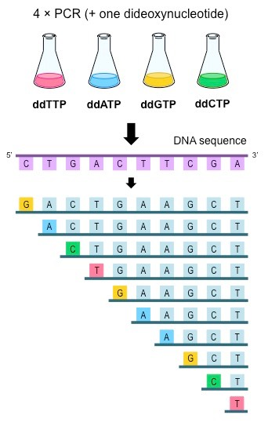
DNA sequencing involves working out the precise order of nucleotides in a sample of DNA
This sequence can then be used to identify genetic diseases, establish maternity/paternity, trace ancestry and forensic science.
Uses sangers method- the solution contains free nucleotides, the primer for the strand we want, DNA polymerase and synthetic nucleotides
The solution is first heated to denature the DNA we want to sequence -> the template
Once the strands have separated, it is cooled again , which allows the primer to bind to the single stranded template
The temperature is then increased again, which allows the DNA polymerase to work along the template and from a new strand from the free nucleotides and synthetic nucleotides in the solution
Each time a synthetic nucleotide is used, the strand will be cut off and no more nucleotides will be added
This process will continue until synthetic nucleotides have been added in all positions of the template

Slide 4
Polymerase chain reaction (PCr) & Gel electrophoresis
Biotechnological techniques provide evidence for evolution by using PCR (to amplify minute samples of DNA to testable amounts), bacterial enzymes and gel electrophoresis to facilitate DNA sequencing of genomes
Describe the process of PCR
Describe the process of gel electrophoresis
Explain how these can be used for DNA sequencing
Explain how they provide evidence for evolution

Slide 5
PCR
Polymerase chain reaction is used to amplify samples of DNA so there are many copies
It uses two primers that will frame the sequence of DNA we want to copy, the double stranded sample, free nucleotides and heat stable DNA polymerase
Denaturation – first, the solution is heated to ~95 C, which causes the sample to denature and the strands to separate
Annealing - the solution is then cooled again to ~ 55 C, which allows the primers to bind to each strand in the 5” to 3” direction
Extension - the solution is now heated to 72 C, which allows the DNA polymerase to attach and the primer and begin to synthesise the new complimentary strands of DNA from the free nucleotides in the solution
After the strands have formed, the solution is heated again the separate the new strands from the template
This process is allows very small amounts of DNA to be amplified, for example from a fossil, which can then be sequenced and compared to genomes of fossil ancestors.

Slide 6
Gel Electrophoresis
Gel electrophoresis is used to separate DNA fragments based on their lengths or molecular weights
This can be used to identify maternity/paternity and determine similarities in DNA sequence that indicate relativity.
The DNA fragments are mixed with a dye, that causes them to sink to the bottom of the wells
The different samples of DNA are placed into wells in the agarose gel at the negative end
A buffer solution is poured over the gel, which prevents the gel from drying out and contains ions that allow the solution to conduct electricity
When the current is applied, the DNA migrates through the gel due to its porous nature
The gel is then stained so that the progress of the DNA fragments can be seen a smear or bands
The fragments that are shortest (have smallest molecular weight) will move faster through the gel, due to their reduced size, so will have travelled further from the wells, while the larger and heavier fragments will be closer to the wells
The distances the fragments have travelled can then be compared to that of the ladder, which contains fragments of known lengths or molecular weights

Slide 7
Conducting Investigations
Conduct investigations, including the use of virtual or real biotechnological techniques of polymerase chain reaction (PCR), gel electrophoresis for deoxyribonucleic acid (DNA)sequencing, and techniques for relative and absolute dating, safely, competently and methodically for valid and reliable collection of data (SIS)
Recall the procedure for conducting: -PCR -Gel electrophoresis

Slide 8
Recombinant dna
Hormones and vaccines are developed using recombinant DNA and associated biotechnological techniques (SHE)
Describe the process of recombinant DNA
Explain the uses of this technology

Slide 9
Recombinant DNA involves introducing DNA into cells, that is from a different organism or has been modified in some way.
This would be useful in treating diabetes mellitus, to produce insulin, as well as vaccines, such as Hepatitis B and other hormone-related conditions.
First the gene we want to manipulate is identify and isolated
This gene is cut out using a restriction enzyme, which cleaves the DNA at the recognition site to create the sticky end
A plasmid, which is a circular ring of DNA, is isolated from a bacterial cell
The same restriction enzyme is used to cut the plasmid at the same recognition site
The enzyme ligase is then used to insert the gene into the plasmid
The plasmid is then reinserted into the bacterial cell
The cell is then cloned rapidly to produce large quantities of the protein or hormone it codes for
Because these proteins or hormones are produced from the patients own DNA, there will not be any of the same side effects as using synthetic hormones

Slide 10
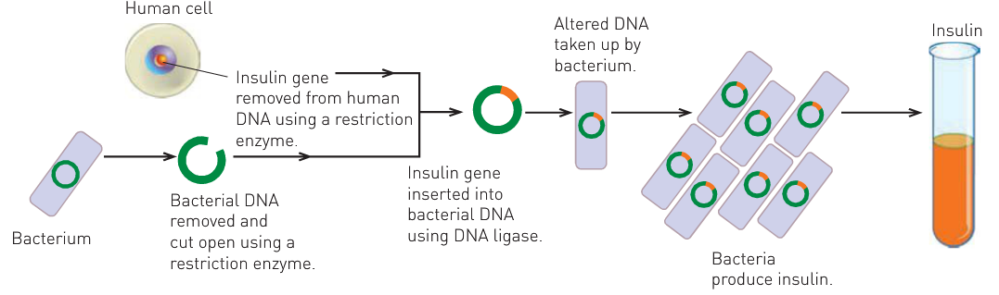
Recombinant DNA Technology To Produce Insulin

Slide 11
Gene therapy
Gene therapy can be used to treat a range of diseases, including diabetes mellitus
Describe the process of gene therapy
Explain the uses of this technology (especially in regards to diabetes)

Slide 12
Gene therapy involves replacing faulty genes with healthy ones -> this involves inserting sections of DNA to treat or prevent the disease
Identify and isolate the healthy gene
Cut it out using a restriction enzyme, at recognition site to produce sticky end
Vector is identified to carry gene to required cells in patient
Obtain deactivated virus
Insert the gene into the viral DNA using ligase
Allow virus to insert insulin gene into patient’s DNA
Patient’s cells begin to produce required protein or hormone
Could be used to treat diabetes, by replacing the faulty insulin gene with a healthy one, so beta cells in pancreas can produce insulin again

Slide 13
Cell replacement therapy
Cell replacement therapy has the potential to treat nervous system disorders including Alzheimer’s and Parkinson’s diseases
Describe the process of cell replacement therapy
Explain the uses of this technology (especially in regards to Alzheimer’s and Parkinson’s)

Slide 14
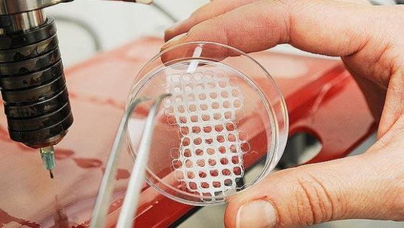
Cell replacement therapy involves using stem cells to regenerate without scarring, repair by stimulating the tissue or replace tissues and organs by creating one in the lab
The stem cells are sourced from the patient (adult stem cells) or from embryonic stem cells
In the lab, these are then differentiated into the required type
A matrix is required -> frameworks for the cells to develop on
Chemical messengers the direct the growth of the cells to produce the tissue
The cells are then re-inserted into patient, which integrate with cells already in the area
-this could be sued to treat Alzheimer's-> replace dying neurons with healthy ones and restore patient brain function

